Slide 1

Customer Data Science
Stand-up Updates
Feb 2017

Slide 2




Key updates
Customer LifeTime Value(g3)
Time to Next Purchase Models
Attrition Models
Discount Sensitivity Models & Analysis
Product Recommendation Engine – Site Testing
Gap Inc Confidential – Do Not Distribute or Copy Without Authorization

Slide 3
ATTRITION MODELS
Customer Data Science
February 2017

Slide 4

Background
Every year, more than 40% of customers from the current customer-base attrite
The attrition can be arrested partially by taking timely action proactively
Campaigns to be run proactively to target customer base with high attrition risk
An Attrition Model will identify (and therefore, generate leads for Attrition Campaigns) that are likely to attrite next year
Statistical/ML model can be used to the same effect
A good model will try to separate expected “Attrition” from expected “Non-Attrition”
Gap Inc Confidential – Do Not Distribute or Copy Without Authorization

Slide 5
Modeling Details
Scope: GP UK
Campaigns: SUMMER/SPRING/FALL/WINTER
Data: Transaction Data, Browse, Email Campaigns Data
Platforms & Packages: Hive, R
Algorithms Tried: Neural Networks, Logistic Regression, Random Forest, XGBoost, GBM, SVM etc.
Behavior
Response Observation
Transactions Data (2015)
1 Year
Purchase Behavior (2016)
1 Year
Creating list of Variables
Data Preparation
(Variable creation, Missing Values & Outlier Treatment)
Data Split into 20 subsets
(Training: 10 subsets,
Validation: 10 subsets)
VARIABLES USED
Weeks since last purchase
Total purchases in past twelve months
Total net sales in past twelve months
Average discount percentage
Ratio of items returned to purchased
Count of distinct divisions shopped from
Validating the models on
Validation Dataset
Finalizing 30 NN Algorithms and ensembling using Median score
Experimenting with various statistical/ML algorithms
Gap Inc Confidential – Do Not Distribute or Copy Without Authorization

Slide 6
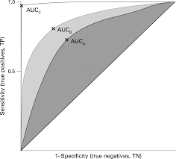
Model Performance: NN Models Ensemble
Sensitivity plus Specificity Max value : 1.38
Accuracy : 69.7%
Area under ROC Curve : 0.755
Gap Inc Confidential – Do Not Distribute or Copy Without Authorization

Slide 7
Sample Output
Emailkey | Score | Segment | Testcontrol
185277378 | 0.9682 | high | test
184595725 | 0.9669 | high | test
44399729 | 0.9513 | high | control
194414246 | 0.6475 | med | test
195643258 | 0.6452 | med | control
168557229 | 0.3982 | low | test
72504675 | 0.3942 | low | control
DUMMY DATA
Gap Inc Confidential – Do Not Distribute or Copy Without Authorization

Slide 8
TIME TO NEXT PURCHASE
Customer Data Science
February 2017

Slide 9

Background
When is the customer most likely to make a purchase ?
Should the customer be targeted in our next campaign?
Who is a better target?
A more frequent buyer or a less frequent buyer
When should a customer be targeted on a longer time scale ?
Gap Inc Confidential – Do Not Distribute or Copy Without Authorization

Slide 10
Modeling Details
Scope: BR US
Platforms & Packages: Hive, Python
Model Choices: Bayesian, Linear, Survival
Bayesian Model
Using the Joint Distribution of features.
Uses Bayes Law to integrate population level and customer level information
Linear Model
Logistic Regression with the same features.
Predicts Re Purchase Occurrence at specified time intervals say one month.
Survival Model
A variant of Cox-Proportionality Hazard Model.
June 2015-June 2016
July 2016-Dec 2016
Training Data
Validation Data
Model Features
Purchase Count in a calendar year.
Variance of Inter Purchase times.
Time in weeks since last purchase.
Distance from beginning /end of month/season of Latest Purchase.
Gap Inc Confidential – Do Not Distribute or Copy Without Authorization

Slide 11
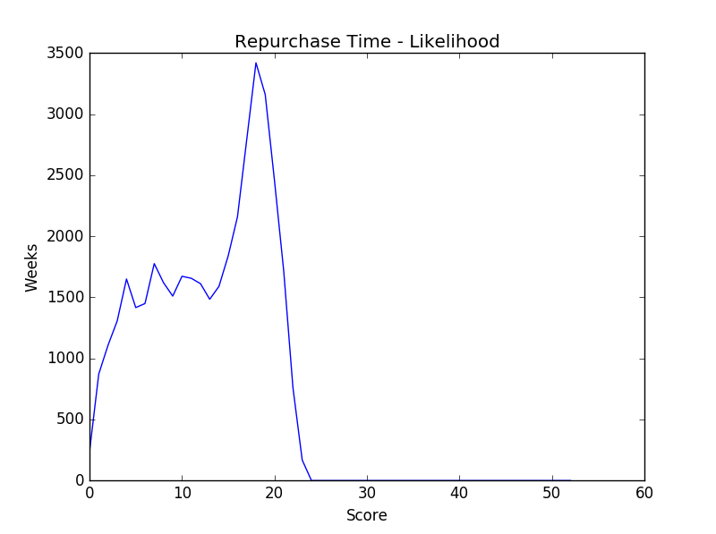
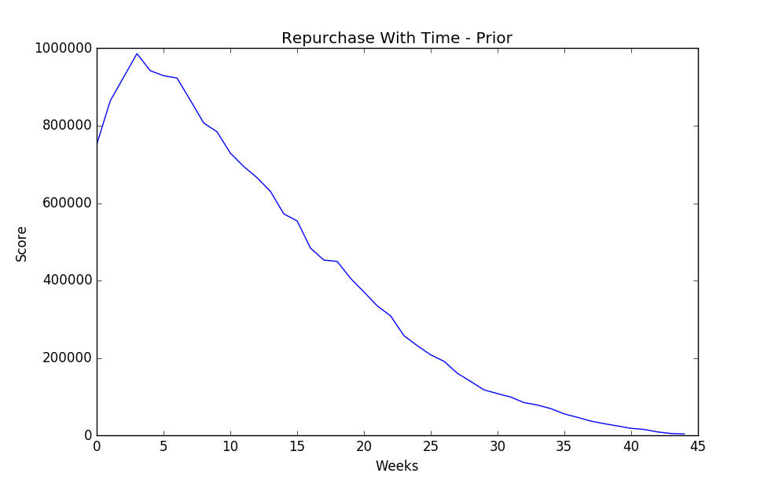
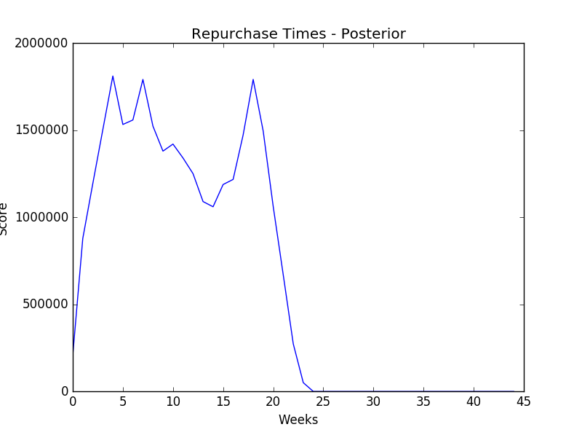
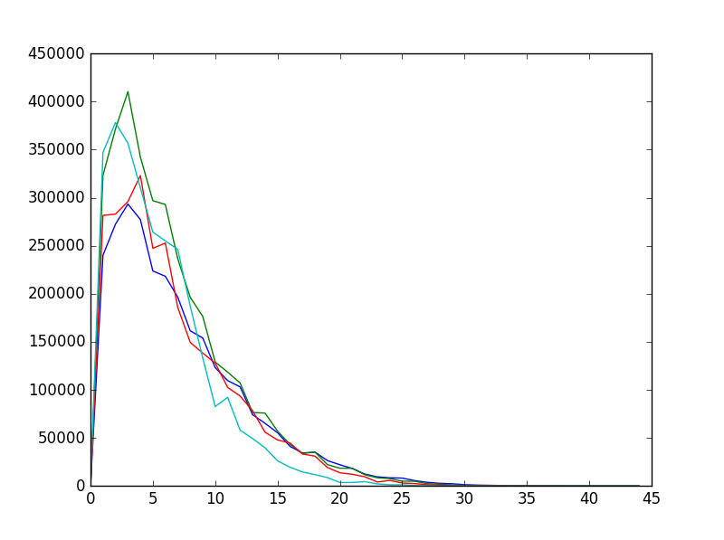
Next Purchase Prediction-
Repurchase Probability Curves
Gap Inc Confidential – Do Not Distribute or Copy Without Authorization

Slide 12
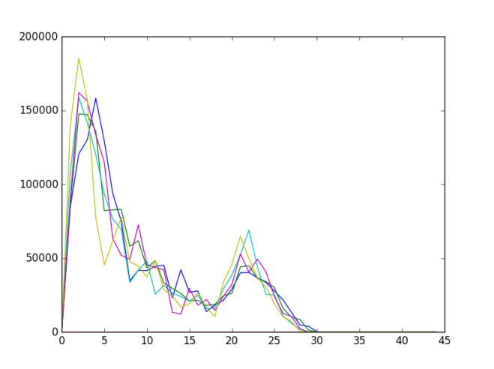
Next Purchase Distribution
Bimodal Next Purchase Distribution
Peak 1 around 2 weeks Period
Corresponds to the Purchase Probability at time 2 weeks.
Trough at around 16-18 week period
Corresponds to Purchase Probability at the end of the season.
Peak 2 around the beginning of next Season.
Variable Impact on Shape of the Distribution
Annual Purchase Count Impacts
Height of the Peaks
Time Elapsed Since Previous Purchase
Position of the peaks and Height of the Peaks
Variance of Inter Purchase Times
Lower Variance Corresponds to an almost unimodal distribution
Higher values explain the spread around each Peak
Gap Inc Confidential – Do Not Distribute or Copy Without Authorization

